Slide 1
Windows OS Security
Windows OS and Windows Security Model

Slide 2

Table of Contents
Brief History of Windows OS
Accounts and Security Principals
Authentication and Authorization
Security Account Manager
Central Directory Service (Active Directory)
Security Identifier (SID)
Access Token
Security Descriptors and Access Control Lists
Logon Process
Sharing and Network Access
User Account Control (UAC)
DPAPI
Certificate Store

Slide 3
Windows OS

Slide 4
Brief History of Windows OS
Domestic Use
MS-DOS
Windows 1
Server
Corporate Use
Windows 2
Windows 3
NT Server 3
Windows 3.1 and 3.11
Windows NT 3
NT Server 4
Windows NT 4
Windows 95
Windows 98
Windows ME
Server 2000
Windows 2000
Server 2003 (+R2)
Windows XP
Windows XP Home
Server 2008
Windows Vista
Windows Vista Home
Server 2008 R2
Windows 7
Windows 7 Home
Server 2012
Windows 8
Windows 8 Home

Slide 5
Windows OS High Level Architecture
User
Space
Third-Party Platforms
Native Applications
C#/VB.Net/etc. Applications
.Net Framework
User Mode Drivers
WindowsAPI (Win32/MFC)
COM/DCOM
Registry
Kernel
Space
NT Kernel
Kernel Mode Drivers
Hardware Abstraction Layer
Hardware
Notes:
Hal.dll - Kernel-mode DLL that interfaces Ntoskrnl and drivers to the hardware. It also acts as a driver for the motherboard itself, supporting soldered components that are not otherwise managed by another driver.
User-Mode Driver Framework (UMDF).
Windows Driver Frameworks (WDF) is a set of libraries that you can use to write device drivers that run on the Windows operating system. WDF defines a single driver model that is supported by two frameworks: Kernel-Mode Driver Framework (KMDF) and User-Mode Driver Framework (UMDF). This topic provides answers to frequently asked questions about UMDF.
UMDF drivers run in a driver host process, which runs in the security credentials of a LocalService account, although the host process itself is not a Windows service. Thus, user-mode drivers are as secure as any other user-mode service. When a UMDF driver issues I/O requests, it can optionally impersonate its client process. Impersonation enables the driver thread to run in the security context of the client so that the system performs access checks against the client's identity rather than that of the driver host process.
A user-mode driver can impersonate its client process only for I/O requests, and not for Plug and Play or other system messages.
At driver installation, the INF file sets a maximum impersonation level for the driver. Impersonation should be set at the lowest level possible to prevent "elevation-of-privilege" attacks. When a client application calls the CreateFile function, it specifies an impersonation level. The driver then requests this level of impersonation for each individual I/O request.
In x64 editions of Windows, Microsoft chose to begin to enforce the restrictions on what structures drivers can and cannot modify. Kernel Patch Protection is the technology that actually enforces these restrictions. It works by periodically checking to make sure that protected system structures in the kernel have not been modified. If a modification is detected, then Windows will initiate a bug check and shut down the system with a blue screen and/or reboot. The corresponding bugcheck number is 0x109, the bugcheck code is CRITICAL_STRUCTURE_CORRUPTION.
The Microsoft Foundation Class Library (also Microsoft Foundation Classes or MFC) is a library that wraps portions of the Windows API in C++ classes,

Slide 6
Windows as dev platform: The old way
Win32
MFC
COM
DCOM

Slide 7
Windows as dev platform: Nowadays
.Net Framework
Open Standards
Open Protocols
Web Services

Slide 8
Windows as dev platform: Subsystem for UNIX-based Applications (SUA)
Source-compatibility subsystem for compiling and running custom UNIX-based applications
Multi-user UNIX environment on Windows
It offers true UNIX-based functionality without any emulation
You cannot cross subsystems SUA vs NT/Win32
Command line only (No X applications)
There is also an open source (GPL) project “Cygwin” that provides unix-like environment for Windows. SUA and Cygwin are based on different architecture.

Slide 9
Windows Security Model

Slide 10
Accounts and Security Principals

Slide 11
Accounts
What does Account mean?
What about computer accounts….
Why we need accounts?
Everyday we use various services to do our job or to enjoy.
How we protect our accounts?
Usually we use username and password

Slide 12



Authentication and Authorization
Authentication refers to a process that verify who you are.
*****
Authorization refers to a process that verify what you are authorized to do.

Slide 13
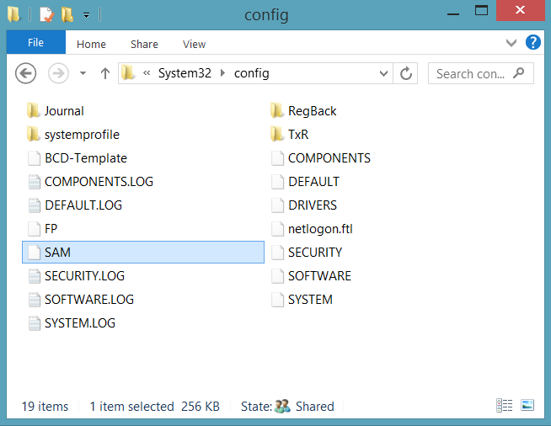
Security Account Manager
A registry hive that stores:
User accounts
Groups
Security information
Accessible only by system processes
Notes:
Accounts Manager (SAM) is a registry file
Stores users' passwords in a hashed format
When a user logs on to a computer using a local account, the SAM process (Samsrv) takes the logon information and performs a lookup against the SAM database, which resides in the windows system32/config directory(Something similar in UNIX, think etc/password). If credential match, then the user can log on to the system, assuming there are no other factors preventing logon, such as logon time restrictions or privilege issues.
Note that SAM does not perform the logon; that is the job of the LSA.
The SAM file is binary rather than text and passwords are stored using the MD4 hash algorithms.
On windows vista, the SAM stores password information using a password-based key derivation function (PBKCS).
In an attempt to improve the security of the SAM database against offline software cracking, Microsoft introduced the SYSKEY function in Windows NT 4.0. When SYSKEY is enabled, the on-disk copy of the SAM file is partially encrypted, so that the password hash values for all local accounts stored in the SAM are encrypted with a key (usually also referred to as the "SYSKEY").
In the case of online attacks, it is not possible to simply copy the SAM file to another location. The SAM file cannot be moved or copied while Windows is running, since the Windows kernel obtains and keeps an exclusive filesystem lock on the SAM file, and will not release that lock until the operating system has shut down or a blue screen exception has been thrown. However, the in-memory copy of the contents of the SAM can be dumped using various techniques, making the password hashes available for offline brute-force attack.

Slide 14




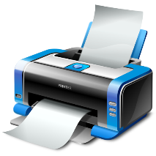


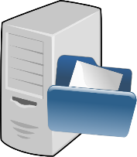
Active Directory Domain Service
Stores accounts (User + Computer) information in a central database
Organizes various objects into a hierarchical tree
Provides information for network resources
Enforces security polices
Audit
Policy
Policy
Notes:
A directory service used to store information about the network resources across a domain and also centralizes the network.
Server based authentication
Centrally managed
Its microsofts’s LDAP directory included with window server 2000 and later.
All client versions of windows, including windows XP and windows Vista, can communicate with AD to perform security operations including account logon
Windows client will authenticate using AD when the user logs on to the computer using a domain account rather than a local account.
Like the SAM scenario, the user’s credential information sent securely across the network, verified by AD, and then if the information is correct, the user can Logon.

Slide 15
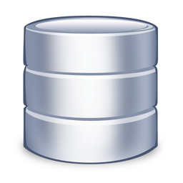
Workgroup
User | Pass
John | P@sswOrd
Workgroup
User | Pass
John | 123456
SAM
SAM
Each computer has local SAM database
Suitable for small networks 2-10 computers

Slide 16
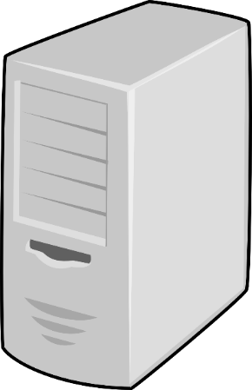
Domain
AD
User | Pass
John | P@sswOrd
Accounts are stored in a central database
More secure
More Scalable
Easy to manage

Slide 17
Security Principals
Entities that the windows security system recognizes
Foundation for controlling access to securable resources
Domain and Local
Domain
User Accounts
Computer Accounts
Groups
Well-known security principals
Local
User Accounts
Groups
Notes:
well-known security principals:
Everyone, Local System, Principal Self, Authenticated User, Creator Owner, and so on.
Security Reference Monitor (SRM)
Kernel Mode Component that
Performs Access Checks
Generates Audit Log Entries
Manipulates User Privileges

Slide 18
Security Identifier (SID)
Windows creates automatically a Security Identifier (SID) for each security principal
S-1-5-21-AAA-BBB-CCC-RRR
Security Identifiers are always unique
Windows uses Security Identifier to recognize you
You can think for SID as Personal ID Number (EGN)

Slide 19
Access Tokens

Slide 20
What is an Access Token?
An access token contains the security information for a logon session
The system creates an access token when a user logs on
Every process executed on behalf of the user has a copy of the token
The system uses the token to control access to securable objects

Slide 21
What information contains an Access Token?
User SID
Groups Membership SIDs
Privileges
System-wide permissions assigned to the logon user account
In Windows 2012, Microsoft introduced a new feature Dynamic Access Control which extends the access token with addition information

Slide 22
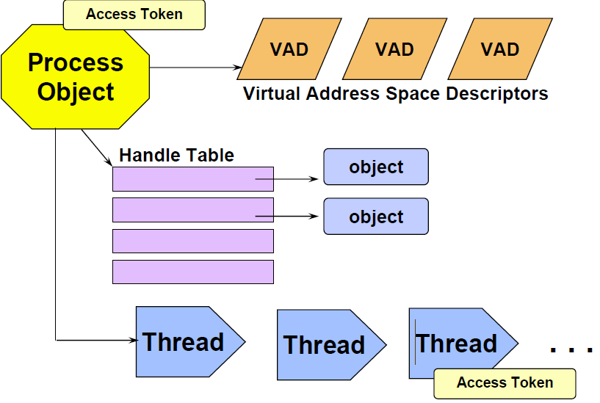
Processes, Threads and Access Tokens
Notes:
Impersonation is the ability of a thread to execute using different security information than the process that owns the thread. Typically, a thread in a server application impersonates a client. This allows the server thread to act on behalf of that client to access objects on the server or validate access to the client's own objects.

Slide 23
Demonstration
How to validate your access token
You have to logoff and logon again to update the information in your access token

Slide 24
Security Descriptors (SD) and Access Control Lists (ACL)

Slide 25
Security Descriptors
Security Descriptors are data structures of security information
Who is the owner of this object?
Who have access to read/write/etc?
Are parent access rules included yes/no?
Security Descriptors can be associated with different OS objects
File System objects
Registry objects
Windows Service

Slide 26
Access Control Lists (ACL)
Objects needing protection are assigned an ACL that includes
SID of object owner
List of access control entries (ACEs)
Each ACE includes a SID and Access Mask
Access mask could include
Read, Write, Create, Delete, Modify, etc.
The Access Mask is different for each type of object (e.g. File, Printer, Registry etc.

Slide 27
Access Control Lists (ACL) (cont.)
Discretionary ACL
Grants or denies access to protected resources such as files, directories, network shares, shared memory, etc.
System ACL
Used for auditing
Notes:
An ACL is a list of permissions attached to an object
The list specifies who or what is allowed to access the object and what operations are allowed to be performed on the object.
Windows has two forms of access control list
Discretionary ACL (DACL):
Grants and denies access to protected resources in windows such as files, shared memory
System ACL (SACL)
Used for auditing and in windows vista used to enforce mandatory integrity policy
Objects that requires protection are assigned a DACL (and possible SACL), which includes SID of object owner as well as a list of access control entries (ACEs)
Each ACE includes a SID and an access mask
Access mask could include an ability to read, write, create, delete , modify and so on

Slide 28


Access Control Process
Group/User | Type
Managers | R/W
Company Users | Read
Administrators | Full
Group/User | Type
S-1-5-21-1085031214-1563985344-725345543-780 | R/W
S-1-5-21-1085031214-1563985344-725345543-639 | Read
S-1-5-21-1085031214-1563985344-725345543-500 | Full
Access Token
Admin
Company Users
Administrators
Access Token
S-1-5-21-1085031214-1563985344-725345543-1131
S-1-5-21-1085031214-1563985344-725345543-639
S-1-5-21-1085031214-1563985344-725345543-500
Full
Access Token
S-1-5-21-1085031214-1563985344-725345543-1139
S-1-5-21-1085031214-1563985344-725345543-639
S-1-5-21-1085031214-1563985344-725345543-2184
Access Token
Secretary
Company Users
Office Assistants
File.docx
Read
Access Token
S-1-5-21-1085031214-1563985344-725345543-701
S-1-5-21-1085031214-1563985344-725345543-639
S-1-5-21-1085031214-1563985344-725345543-780
R/W
Access Token
Boss
Company Users
Managers

Slide 29
Demonstration
File System Permissions
Registry Permissions
Because of the object nature of Windows, ACLs can be associated with any object created by NT Object subsystem

Slide 30
Logon Process

Slide 31
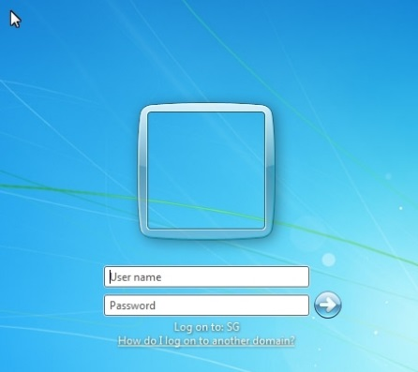

Logon Process
Interactive Logon (WinLogon)
Network Logon (NetLogon)

Slide 32
Log on
The interactive logon process is the first step in user authentication and authorization.
LSA Service
OR
SAM
Active Directory

Slide 33
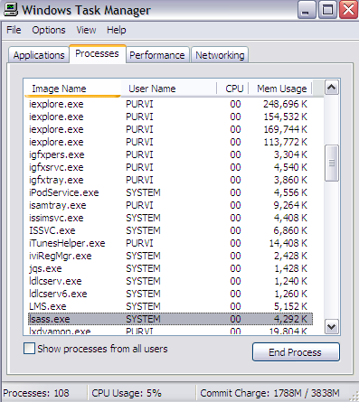
Local Security Authority (LSA)
Issues security access tokens to accounts
Responsible for enforcing local security policy
Lsass.exe
User mode
Key component of the logon process

Slide 34
Network Logon in Workgroup
User | Pass
John | P@sswOrd
User | Pass
Moyra | 123456
John | 123456
Workgroup
SAM
SAM

Slide 35



Network Logon in Domain
User | Pass
John | P@sswOrd
AD

Slide 36
Authentication Protocols
Authentication Protocols
Kerberos
NTLMv2
Authentication APIs
Win32 Security Support Provider Interface (SSPI)
.Net Framework System.Net.Security.NegotiateStream

Slide 37
Local Security Policy

Slide 38
Local Security Policy
Account Policies
Password Policy
Account Lockout Policy
Local Polices
Audit Policy
Users rights assignment
Security Options
Application Control Policies
Other (Firewall/EFS/IPSec)

Slide 39
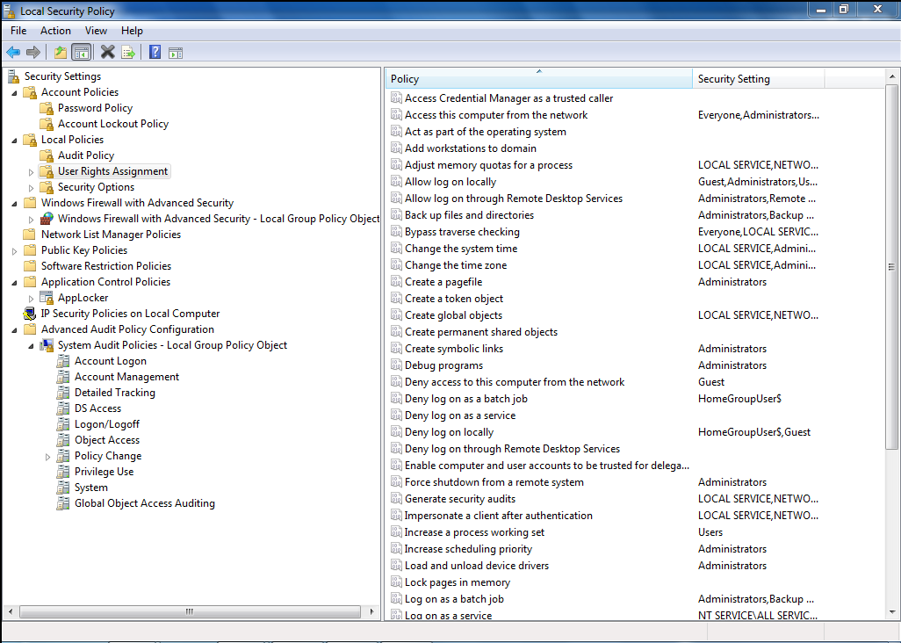
Local Security Policy (cont.)

Slide 40


Group Policy
Policy
Policy
Policy
AD DB
Manage user and computer settings
Enforce IT policies
Simplify administrative tasks
Implement security settings
Can be easily extended

Slide 41
Windows Services and Service Accounts

Slide 42
What is a Service?
Long running program that operates in the background
Designed to require no interactive user intervention
Similar in concept to a Unix daemon
Can be configured to start with the operating system

Slide 43
Service startup types
Automatic
Automatic (Delayed)
Manual
Disable
Windows allows you to create dependencies if you want certain services to start before others.

Slide 44
Service Control Manager (SCM)
A special system process
Responsible to interacts with Windows Service processes
Start
Stop
Interacts through a well-defined API

Slide 45
Develop Windows Service (C#)
public class MyService : System.ServiceProcess.ServiceBase
{
public MyService()
{
InitializeComponent();
}
protected override void OnStart(string[] args)
{
//Add code that is executed on start
}
protected override void OnStop()
{
//Add code that is executed on stop
}
}

Slide 46
Service Accounts
Windows Services also runs from a context of account and also have access tokens
Local or Domain
Special Accounts
LocalSystem
LocalService
NetworkService

Slide 47
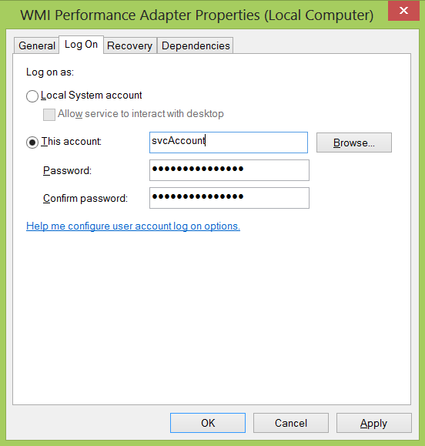
Log On Settings

Slide 48
User Account Control (UAC)

Slide 49
User Account Control
How it works: When your consent is required to complete a task, UAC will prompt you with a dialog box
Tasks that will trigger a UAC prompt include anything that will affect the integrity or security of the underlying system
This is a surprisingly long list of tasks
UAC works slightly differently with standard user and administrator-class accounts
UAC is working only for interactive sessions!

Slide 50
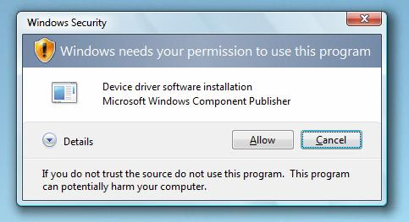
UAC Consent UI: Type 1
Prompt: Windows needs your permission to continue
Why you see this: You attempt to change a potentially dangerous system setting

Slide 51
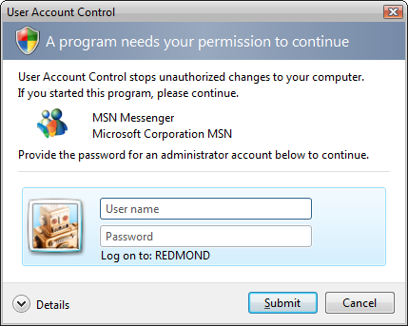
UAC Consent UI: Type 2
Prompt: A program needs your permission to continue
Why you see this: An external application with a valid digital signature is attempting to run with admin privileges

Slide 52
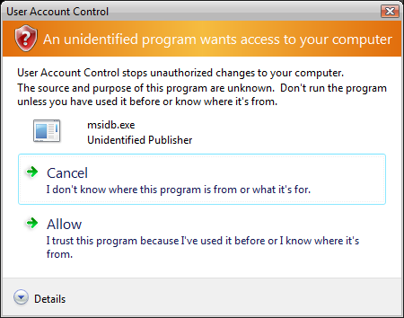
UAC Consent UI: Type 3
Prompt: An unidentified program wants access to your computer
Why you see this:
in external application without a valid digital signature is trying to run

Slide 53
UAC: What’s really happening
Administrator accounts logon with a mixed token
Half of this mixed token is a standard user token
The other half, the administrator token, is invoked only when required:
You can do so manually (run as)
Automatically (certain tasks in OS are tagged as requiring an admin token)
Notes:
Half of this mixed token is a standard user token: this is what is typically used to determine your memberships and privileges
The other half, the administrator token, is invoked only when required: you can do so manually (run as) or automatically (certain tasks in OS are tagged as requiring an admin token)
The other half, the administrator token, is invoked only when required: you can do so manually (run as) or automatically (certain tasks in OS are tagged as requiring an admin token)

Slide 54
DPAPI
OS service that provides confidentiality of data by using encryption
Password-based data protection service
Easy-to-use service
Two Functions
CryptProtectData()
CryptUnprotectData()

Slide 55
Certificate Store
Physical Stores
Local machine
Current user
Logical Stores
Personal
Trusted Root Certification Authorities
Other
Notes:
Be aware that all current user certificate stores inherit the contents of the local machine certificate stores. For example, if a certificate is added to the local machine Trusted Root Certification Authorities certificate store, all current user Trusted Root Certification Authorities certificate stores also contain the certificate.

Slide 56
Where you can find resources?
TechNet
https://technet.microsoft.com/
MSDN
https://msdn.microsoft.com/
Windows Protocols Specification
https://msdn.microsoft.com/en-us/library/jj712081.aspx

Slide 57
Windows Security Model

Slide 58
Windows and the DLL Hell
Dynamic-link library (DLL) – A shared library concept in Windows OS
Dynamic linker finds and loads DLLs needed by an executable (at runtime)
Checks the program directory
Checks System32 and System
Checks the current working directory
Checks for directories specified by the PATH environment variable
.Net Framework Global Assembly Cache (GAC)
Primary store of .Net shared DLL files
Removes the issue of DLL hell
Strong Naming concept
Notes:
Microsoft Windows checks the registry to determine the proper place to load DLLs that implement COM objects, but for other DLLs it will check the directories in a defined order. First, Windows checks the directory where it loaded the program (private DLL[7]); any directories set by calling the SetDllDirectory() function; the System32, System, and Windows directories; then the current working directory; and finally the directories specified by the PATH environment variable.[9] Applications written for the .NET Framework framework (since 2002), also check the Global Assembly Cache as the primary store of shared dll files to remove the issue of DLL hell.

