Slide 1
Windows OS Security
Internet Information Server (IIS) Security

Slide 2

Table of Contents
Brief History of Internet Information Server (IIS)
IIS Architecture
HTTP.SYS
Processing Client Requests
Security Context
Authentication
HTTPS
Secure Administration
Creating a Managed Code IIS Module

Slide 3
Internet Information Server History

Slide 4
What is Internet Information Server?
Internet Information Services (IIS) is an extensible web server created by Microsoft
Web Server Oops!?
  HTTP and HTTPS
  FTP and FTPS
  SMTP
IIS 1.0 was released as a free add-on for Windows NT 3.51
IIS 8.5 was released in Windows 2012 R2

Slide 5
If(IIS.Version < 7) { saygoodbay(); }
IIS 7 was introduced in Windows Server 2008
All version prior 7 have different architecture!
IIS 7 and all successors are based on new modern architecture
  Modern Modular Architecture
    Install only modules that you really need (Small attack surface)
    You can find many modules from Microsoft and other companies
  Modules extend server functionalities trough a public module API
  Most of the integrated IIS functions are provided by modules
  Support for Managed Code Modules
  Extensible XML Based Configuration Engine
  Control APIs for managing state

Slide 6
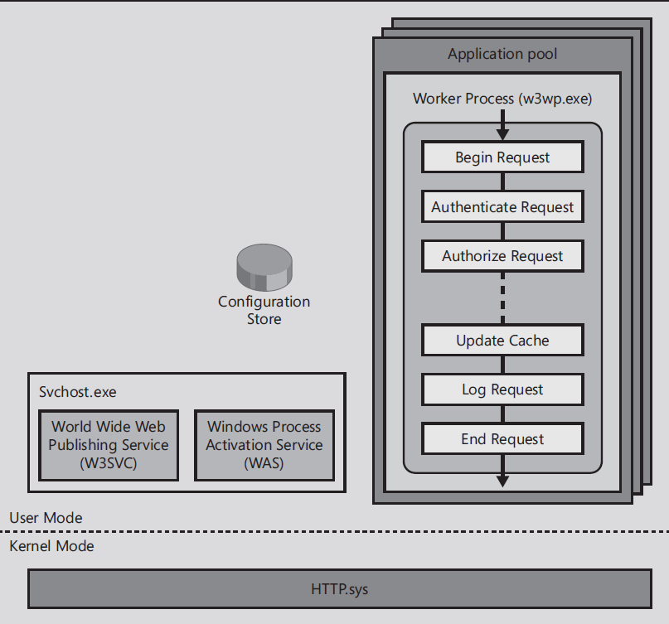
IIS Architecture

Slide 7
HTTP.SYS
MS15-034: Vulnerability in HTTP.sys could allow remote code execution: April 14, 2015
What is it?
  Kernel-mode HTTP stack/listener
  Always running
Reliability Features
  Process routing based on URL
  Request queues: kernel-mode queuing
Performance Features
  Kernel-mode response cache
  Text-based and binary logging

Slide 8
Processing Client Requests
When an HTTP request arrives at the server
  HTTP.SYS intercepts the request and check the configuration information
  HTTP.SYS parses the URL path to determine which site/app the request is for
  HTTP.SYS forwards the request to a worker process
  The worker process begins a request processing pipeline to execute the request
  At the end of the processing, a response is generated and returned to HTTP.SYS
  HTTP.SYS sends a response to the client
Each application runs within an isolated application pool
One or more worker processes serve an application pool

Slide 9
Security Context

Slide 10
IIS AppPools
What is an IIS AppPool
  Application pools host one or more web applications
  Worker Process share the same configuration
  Enables applications isolation for better security
You can configure Web applications to run in:
  Default application pools
  You can create a new AppPool
AppPool Identity
  Identity under which worker processes in the application pool will run
  You can create custom user account
Notes:
The worker process serves as the process boundary that separates each application pool so that when one worker process or application is having an issue, other applications or worker processes are not affected.

Slide 11
ASP.NET Impersonation
Impersonation is the ability of a thread to execute using different security context
Typically, this allows the server thread to act on behalf of a client user when access objects
By default, it is disabled
You can also programmatically impersonate users

Slide 12
Authentication

Slide 13
Authentication Modules
Anonymous Authentication
Basic Authentication
Digest Authentication
Forms Authentication
Windows Authentication

Slide 14
Windows Integrated Authentication
Encapsulate SSPI (Security Support Provider Interface) authentication schema in HTTP Authorization/WWW-Authentication
Supports Kerberos and NTLM
Provides Single Sign On (SSO)
Browser
  Internet Explorer
  Mozilla
  Chrome 8.0
  Safari
Works only on Windows…….

Slide 15
Creating a Managed Code
IIS Module

Slide 16
Required Steps
Create class that implements IHttpModule
Write code for the Init Method
Initialize module
Subscribe to events
Write code for the subscribed events
Implement the Dispose method (required)
Register the module in the Web.config or Applicationhost.config file

Slide 17
Creating a Class from IHttpModule
public class CustomAuthenticationModule : IHttpModule
{
void Init(HttpApplication context)
{
}
void Dispose()
{
}
}

Slide 18
Integrated pipeline: Events
Request Events
  Begin
  Authenticate
  Authorize
  Resolve Cache
  Map Handler
  Acquire State
  PreExecute Handler
  Execute Handler
  Release State
  Update Cache
  Log
  End
On Demand Events
  SendResponse
  ReadEntityBody
  MapPath
Global Events
  Initialize / Shutdown
  Config Change / File Change
  Application Start / Stop
  Health Check
  Trace Event
  More

Slide 19
Creating a Class from IHttpModule
public void Init(HttpApplication context)
{
//
// Subscribe to the authenticate event to perform the
// authentication.
//
context.AuthenticateRequest += new
EventHandler(this.AuthenticateUser);
//
// Subscribe to the EndRequest event to issue the
// challenge if necessary.
//
context.EndRequest += new
EventHandler(this.IssueAuthenticationChallenge);
}

Slide 20
IIS Security

Slide 21
HTTPS

Slide 22
HTTP.SYS Binding
When you configure HTTPS in IIS the SSL Binding information is stored in two different places
  %windir%\System32\inetsrv\config\applicationHost.config
  HTTP.sys configuration

Slide 23
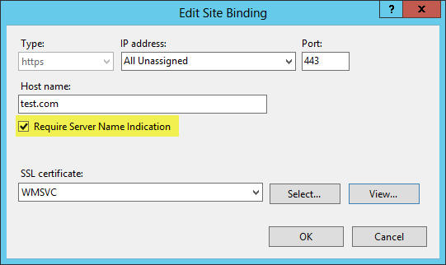
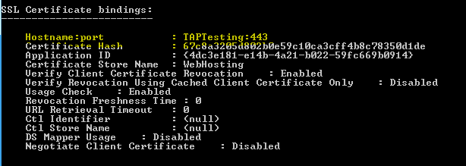
Server Name Indication (SNI)
What is SNI?
  TLS extension that include a virtual domain as a part of SSL negotiation
  Introduced in IIS 8
Client browsers have to support SNI
HTTP.SYS Binding

Slide 24
IIS Secure Administration

Slide 25
Securely Delegate
IIS 7.0 enables administrators to securely delegate site and application administrative control
to developers and content owners without administrative privileges on the server

Slide 26
IIS Logging and Tracing
Logging
Failed Event Tracing
  Automatic event trace logging on error condition
  Detailed trace events across web platform stack

